Slide 1
Multi-view 3D Pose Estimation
20150342 Junkyu Park
20170317 Seungho Baek
NCSOFT Vision AI Lab Human Pose Team Yeongeon Lee

Slide 2
Objective
Improve 3D pose estimation accuracy
using multi-view images

Slide 3
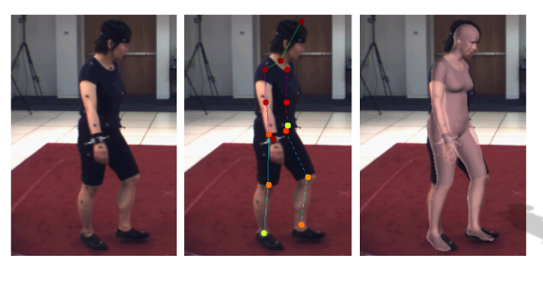
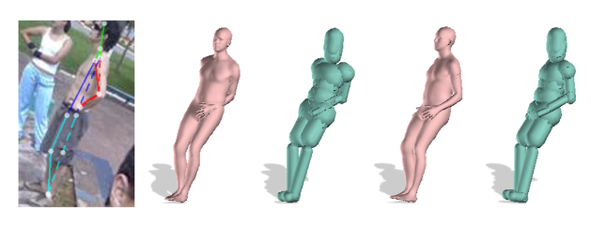
Related work - SMPLify
Image -> 2D annotation -> 3D annotation -> OPTIMIZATION

Slide 4
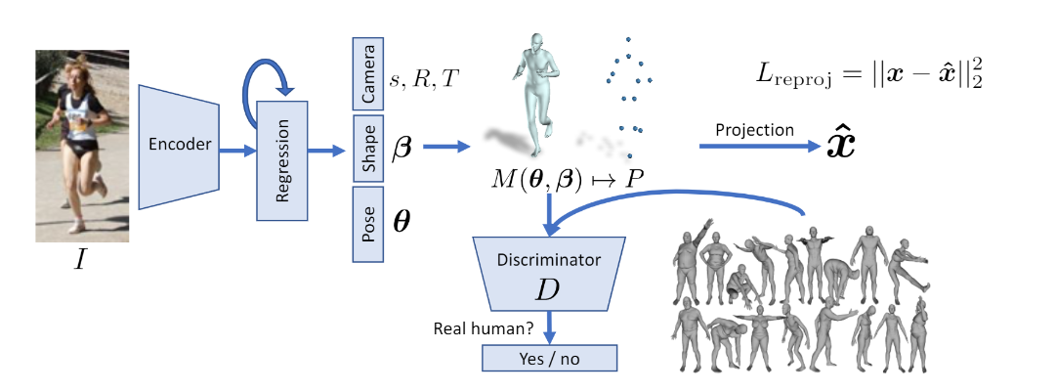
Related work - HMR
Image -> 3D annotation(using Discriminator)

Slide 5
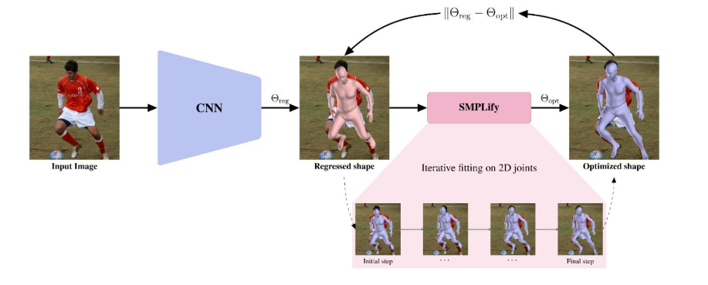
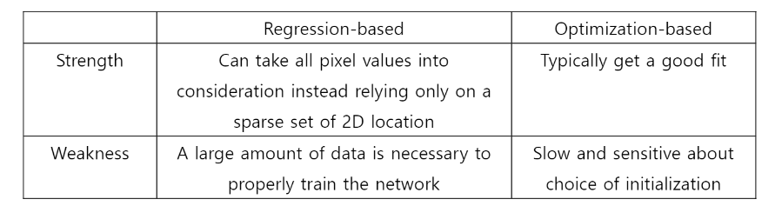
Related work - SPIN
HMR
Use multi-view fitting
(Todo forward)

Slide 6
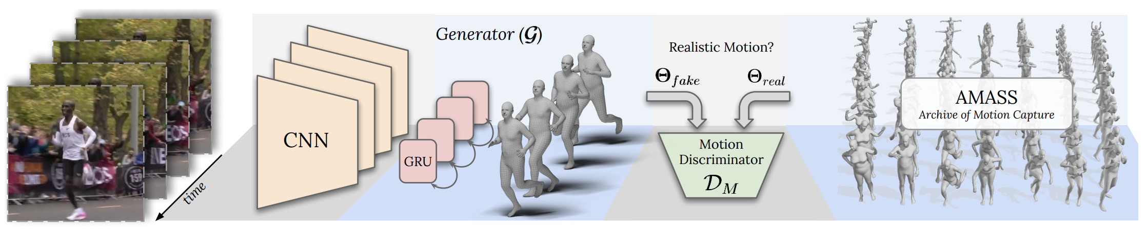
Related work - VIBE
GRU outputs latent variables containing information incorporated from past and future frames.

Slide 7
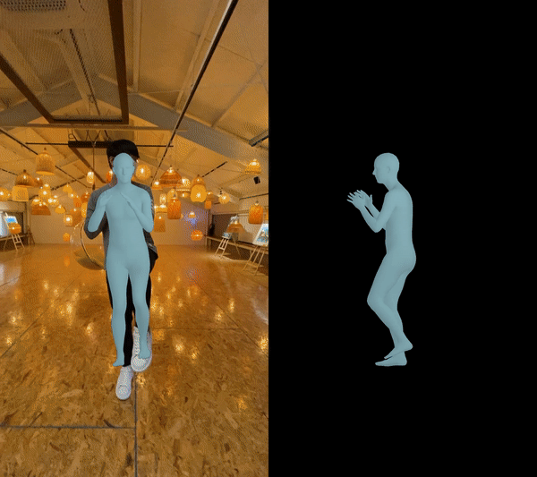
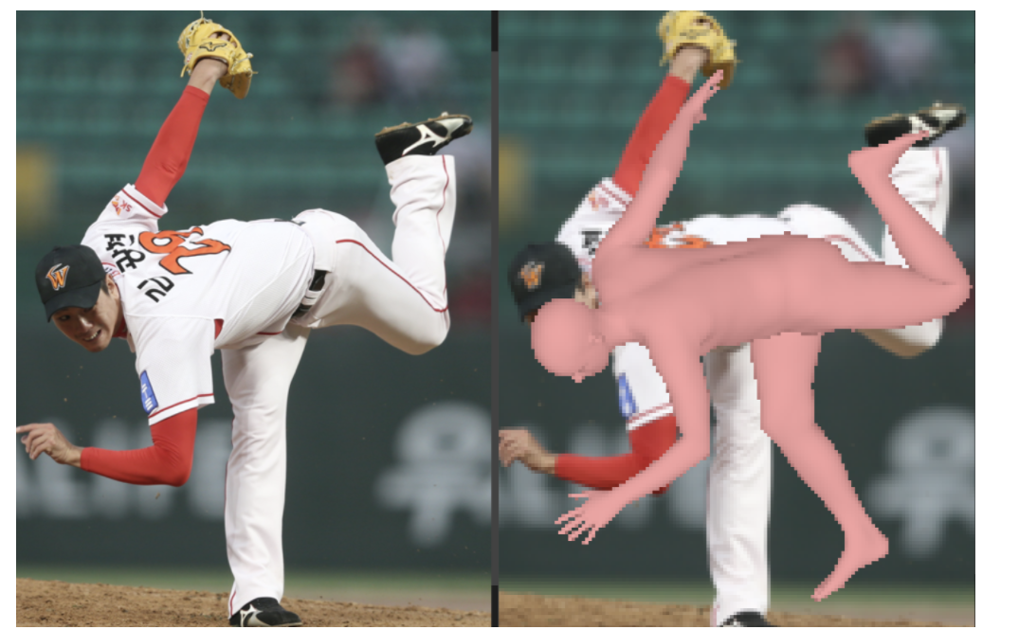
Problem Statement
Low accuracy for unusual pose
Not enough multi-view datasets with Ground Truth

Slide 8
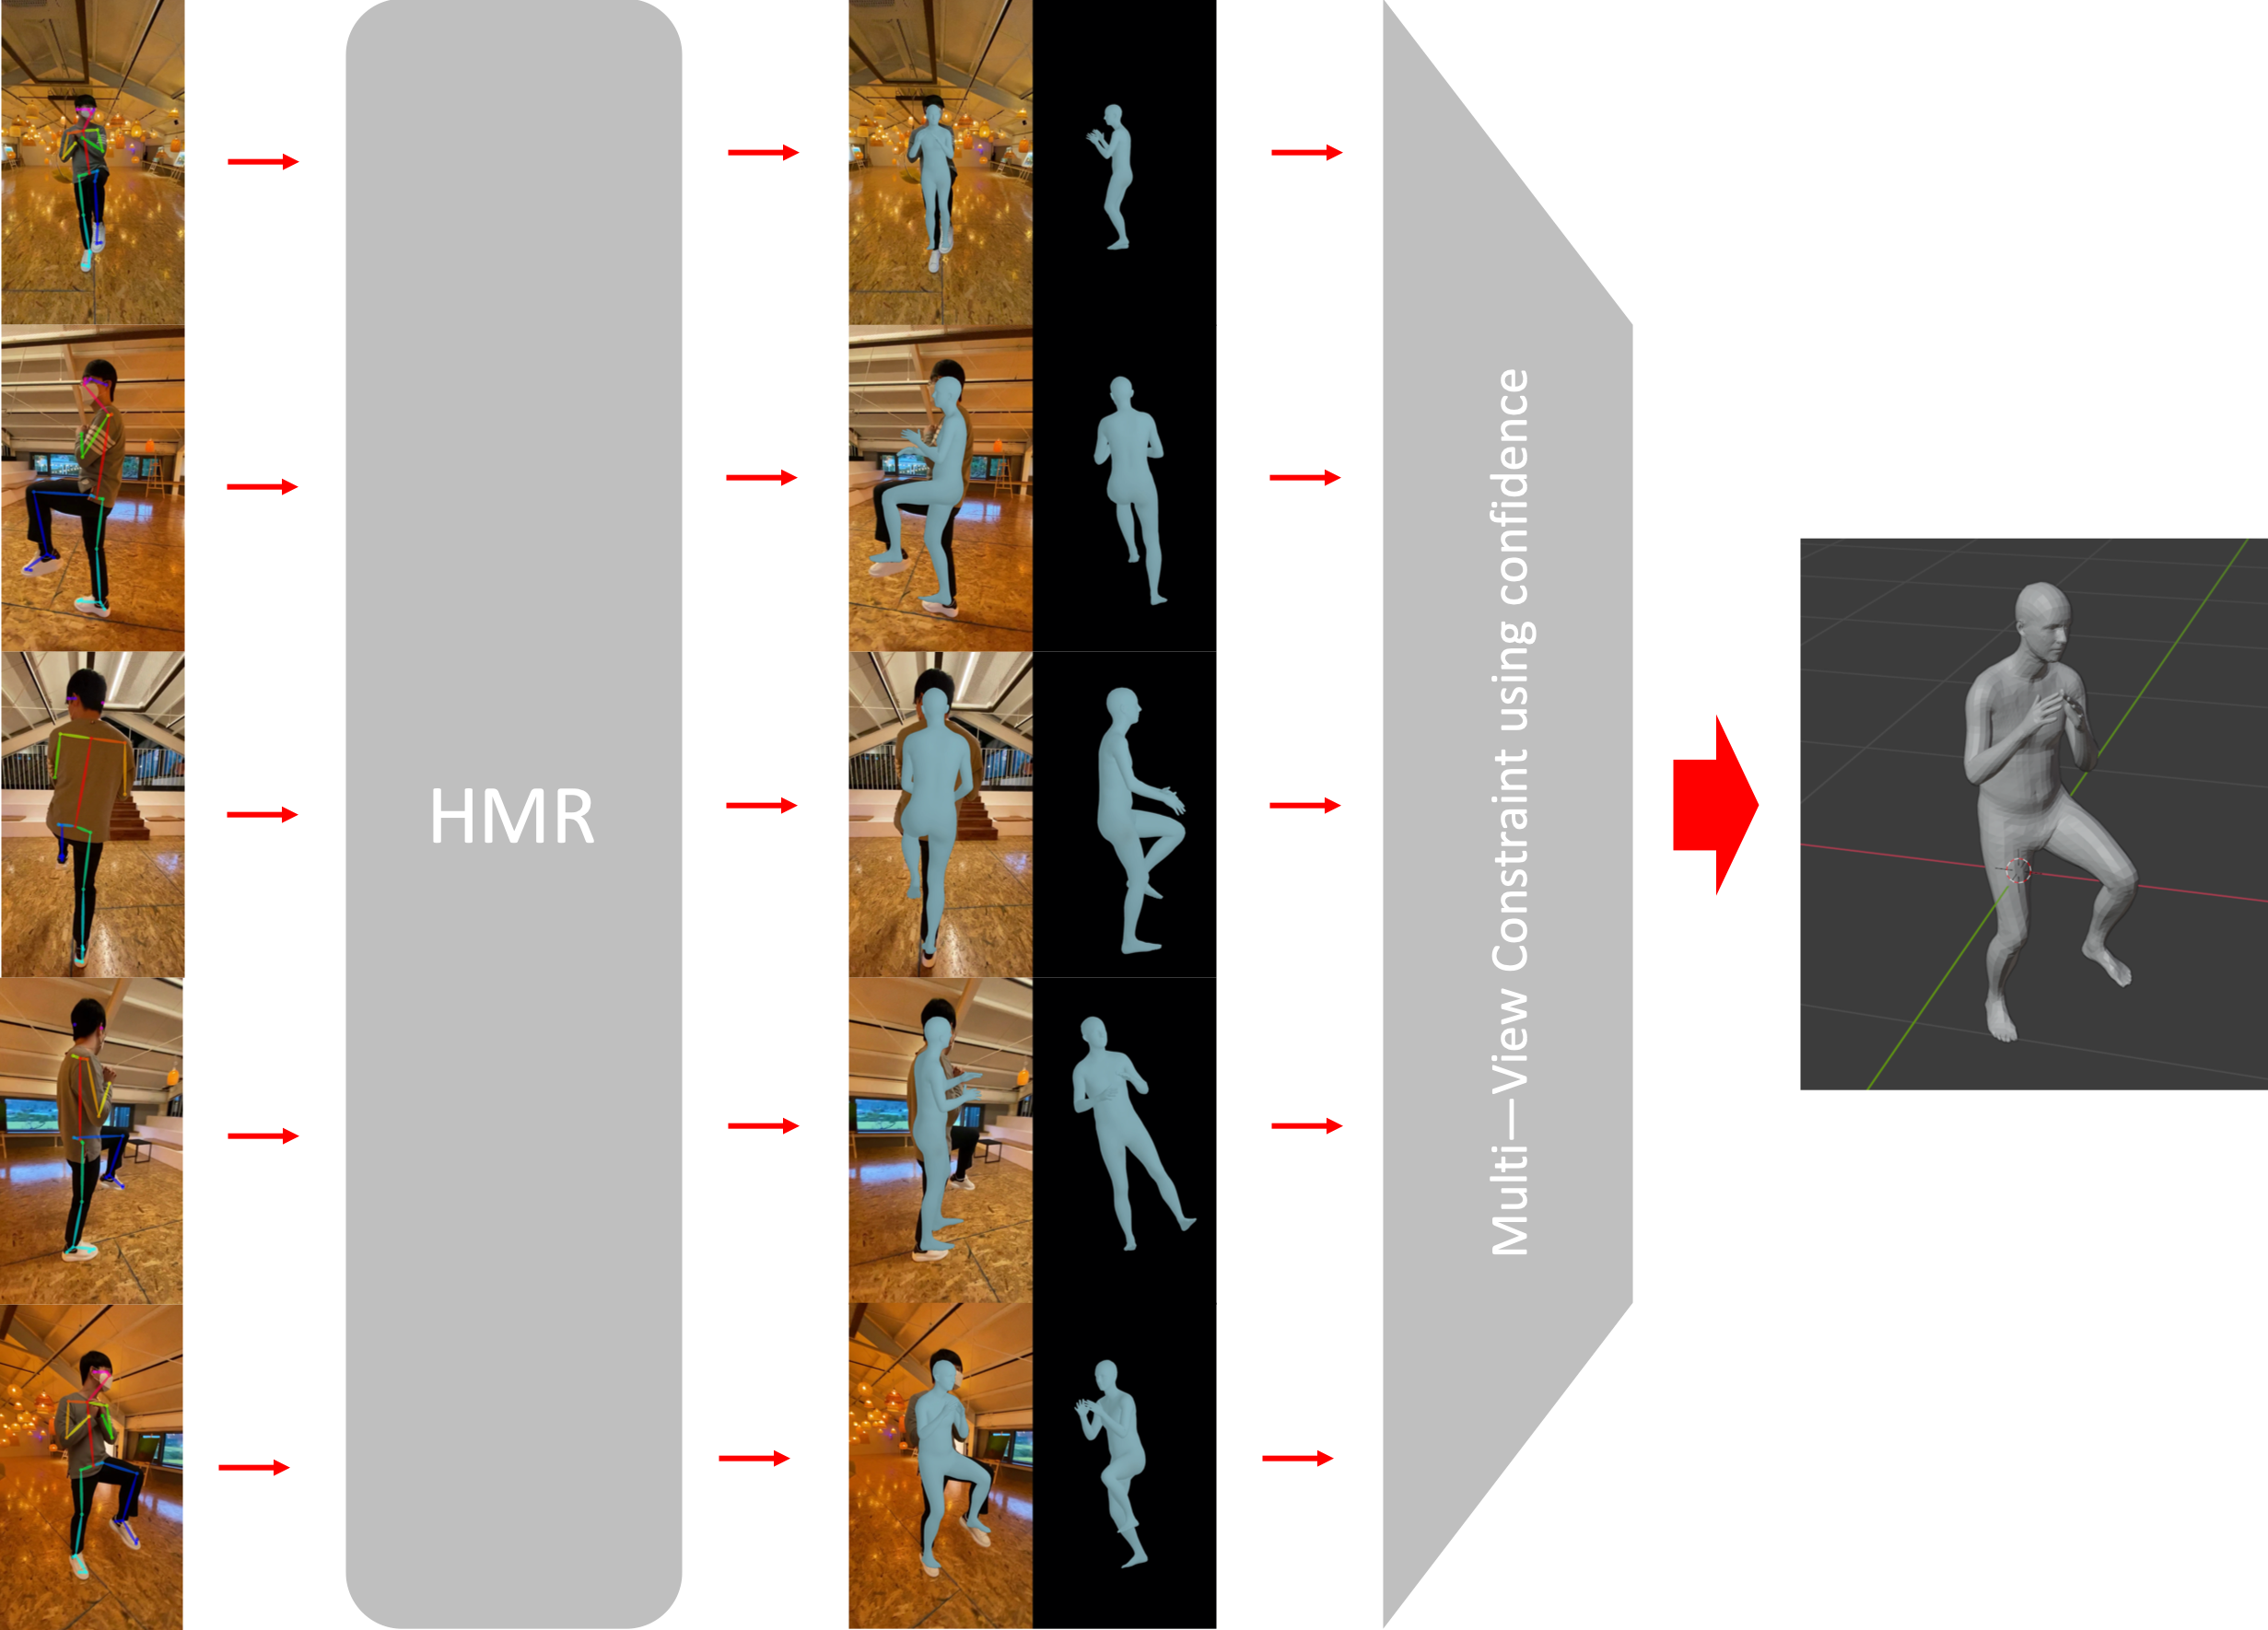
Solution
Find confidence map – SMPL relationship
Extend SPIN Model

Slide 9
Architecture
Link
Downloader
Openpose or YOLO + DeepSort
Multi image HMR
Pre-processing
Suggested constraint calculator
SMPL
Model (Extend SPIN model)

Slide 10
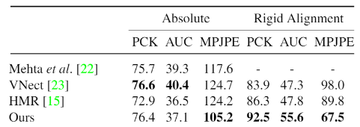
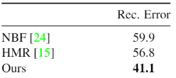
Requirement Analysis
Functional Requirement
Design multi-view constraint and get better result
Modify the model to receive multi-view input.
Get confidence map from the openpose result.
Find relationship between confidence map and SMPL parameters.
Single-view
<For MPI-INF-3DHP>
Non-functional Requirement
Reconstruction error of multi-view 3D pose estimation should be better than existing models for human 3.6m
PCK, AUC, MPJPE loss value should be lower than existing models for MPI-INF-3DHP dataset
Single-view
<For Human3.6m>

Slide 11
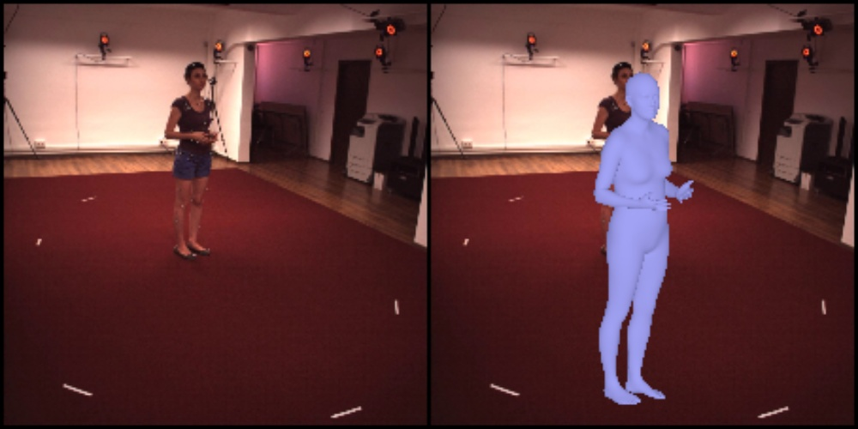
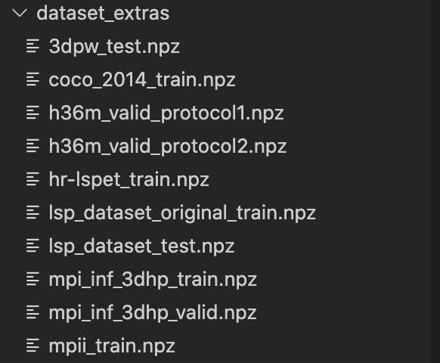
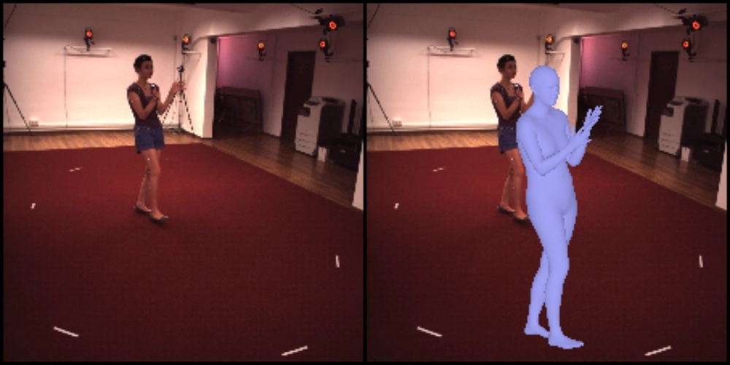
Acquired Datasets
Human3.6m(with SMPL), MPI(with SMPL), 3dpw, coco, etc

Slide 12
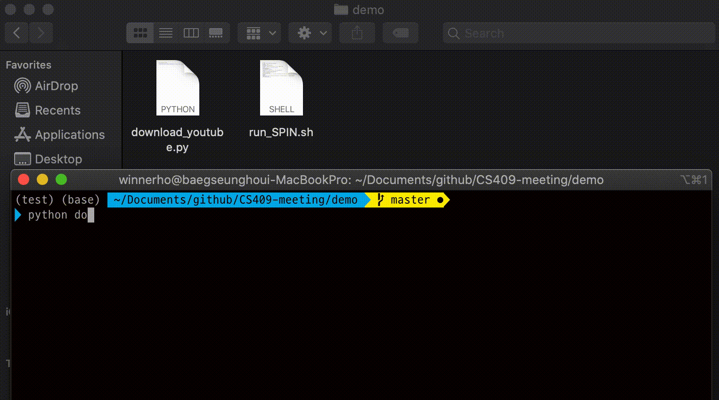
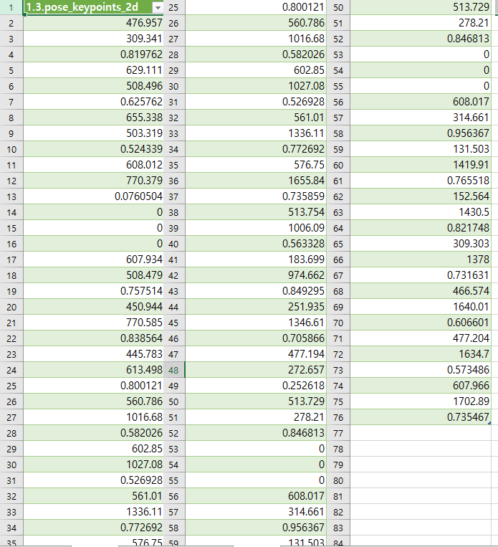
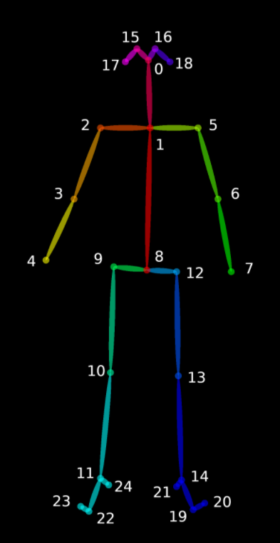
Detailed Pre-processing pipeline
For 25 body parts
(3n-1)th data = x position of body part
(3n)th data = y position of body part
(3n + 1)th data = confidence of body part

Slide 13


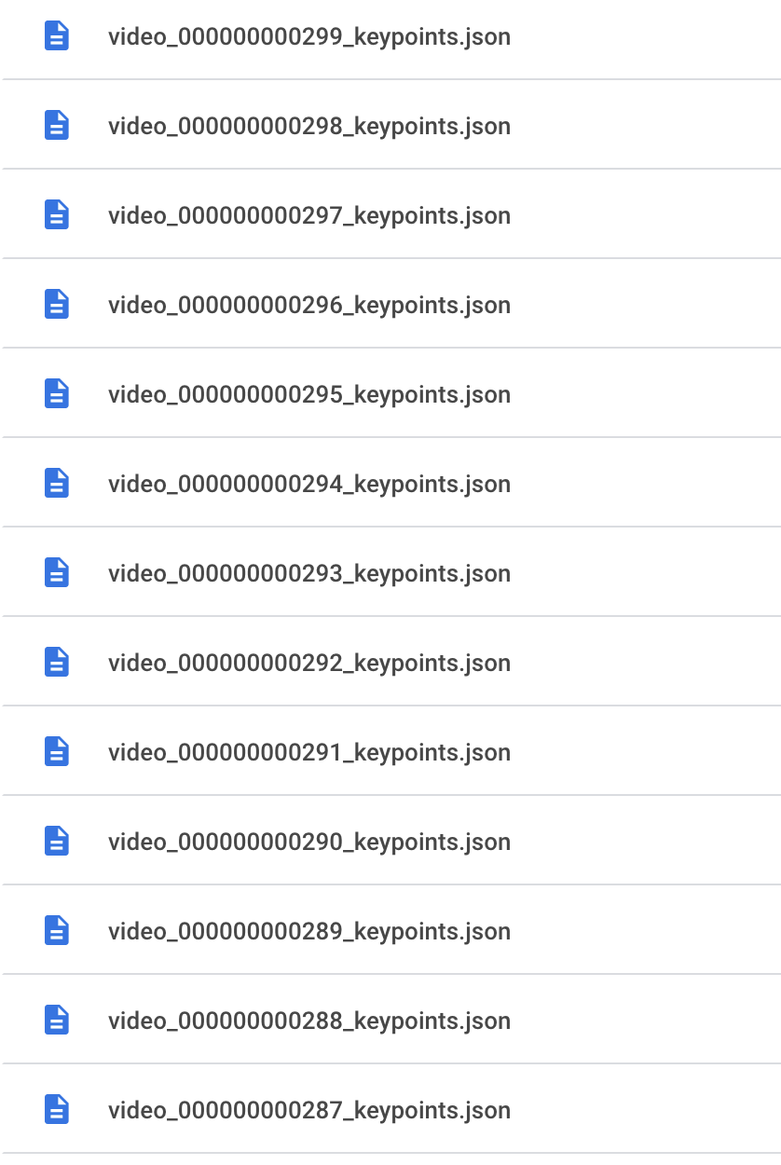
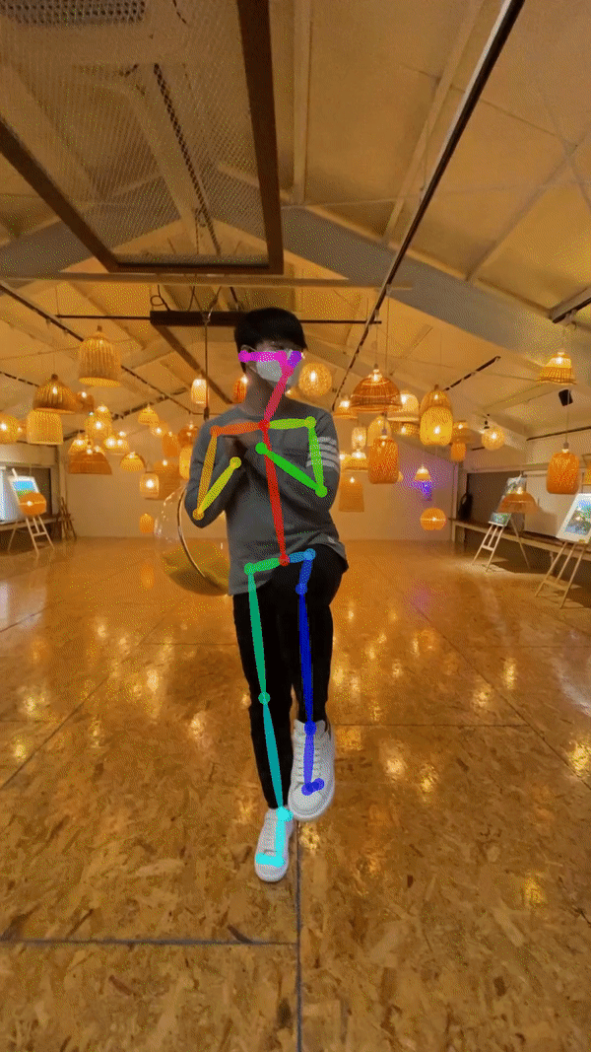
Visualizing
Youtube Datasets (Mannequin challenge)
Our Datasets (Recorded by camera/phone)

Slide 14
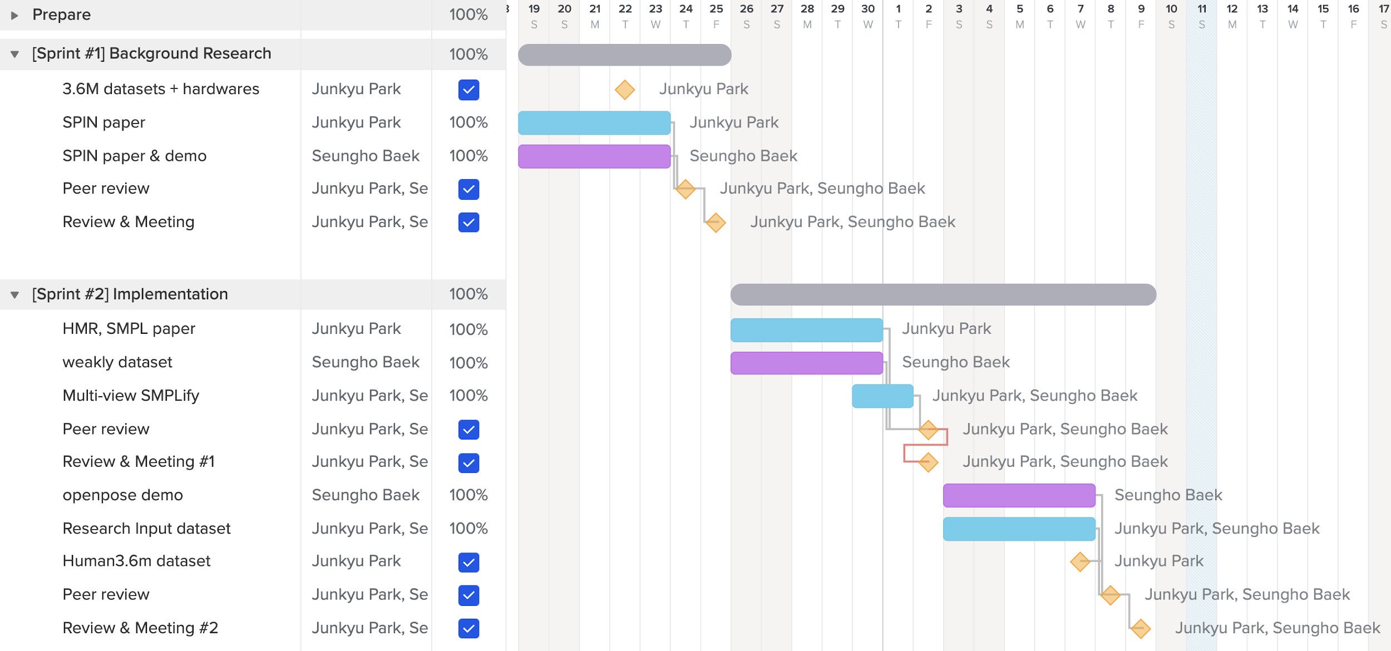
Schedule : before mid presentation

Slide 15
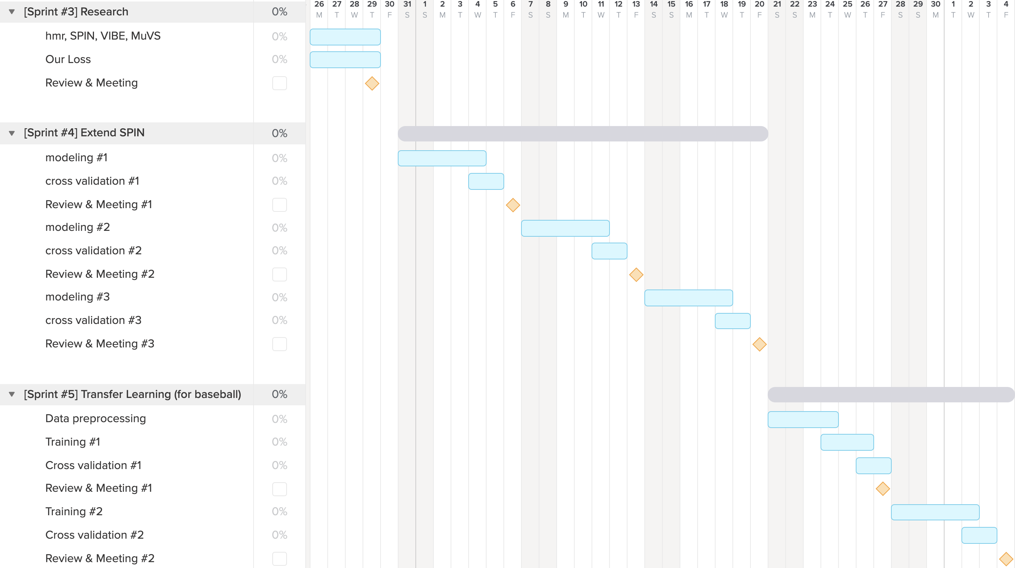
Schedule : after mid presentation

Slide 16
Role and Responsibility
Seungho Baek (Team Leader)
Done
Run SPIN demo / Preprocess datasets for training / suggest constraint design
To do
Make designed model
Junkyu Park
Done
HMR, SMPLify, SPIN paper review / Get Human3.6m dataset / dataset labeling / environment settings
To do
Acquire dataset and modeling
Yeongeon Lee (Mentor, NCSOFT)
Done
Advice for project proceeding / Supply Human3.6m datasett
To do
Feedback about our design and modeling / Supply needed datasets.

